Slide 1
DATA ANALYTICS AND VISUALIZATION
(24DSB3101)
Machine Learning-Based Healthcare Data Analytics for Early Disease Risk Predication
Team Members
E. Supraja - 2420030357
M. Varshitha - 2420030479
C. Keerthana - 2420030581
CH. Bhargavi - 2420030588
Under the Esteemed Guidance of
Dr . KATANGURI SWAPNIKA (CSE)

Slide 2
Contents
Problem Statement
Objectives
Literature Survey
Research Gap
Innovation & Creativity
Novelty
Feasibility
Project Plan
Proposed Architecture/Methodology

Slide 3
PROBLEM STATEMENT
Problem Statement
Healthcare data can help predict chronic disease risks, but traditional ML models are often difficult to interpret. This project uses disease-specific ML models with Explainable AI (XAI) to provide transparent predictions. The framework supports early risk assessment and data-driven clinical decision-making. It also improves trust and understanding of AI-based healthcare predictions.

Slide 4
OBJECTIVES
To analyse and preprocess healthcare datasets using Pandas, NumPy, Matplotlib, Seaborn, and automated profiling techniques to identify data-quality issues, distributions, correlations, and significant risk factors.
To develop and evaluate disease-risk prediction models using Logistic Regression, Decision Tree, Random Forest, and XGBoost based on Accuracy, Precision, Recall, F1-Score, and ROC-AUC metrics.
To enhance the interpretability of disease-risk predictions using SHAP-based global and local explanations to identify the key factors influencing individual predictions.
To develop an interactive Streamlit-based healthcare analytics dashboard that presents disease-risk probabilities, key risk factors, model performance, and explainable prediction results for effective decision support.
To evaluate and compare the developed models to identify the most accurate and reliable model for early disease-risk prediction.

Slide 5
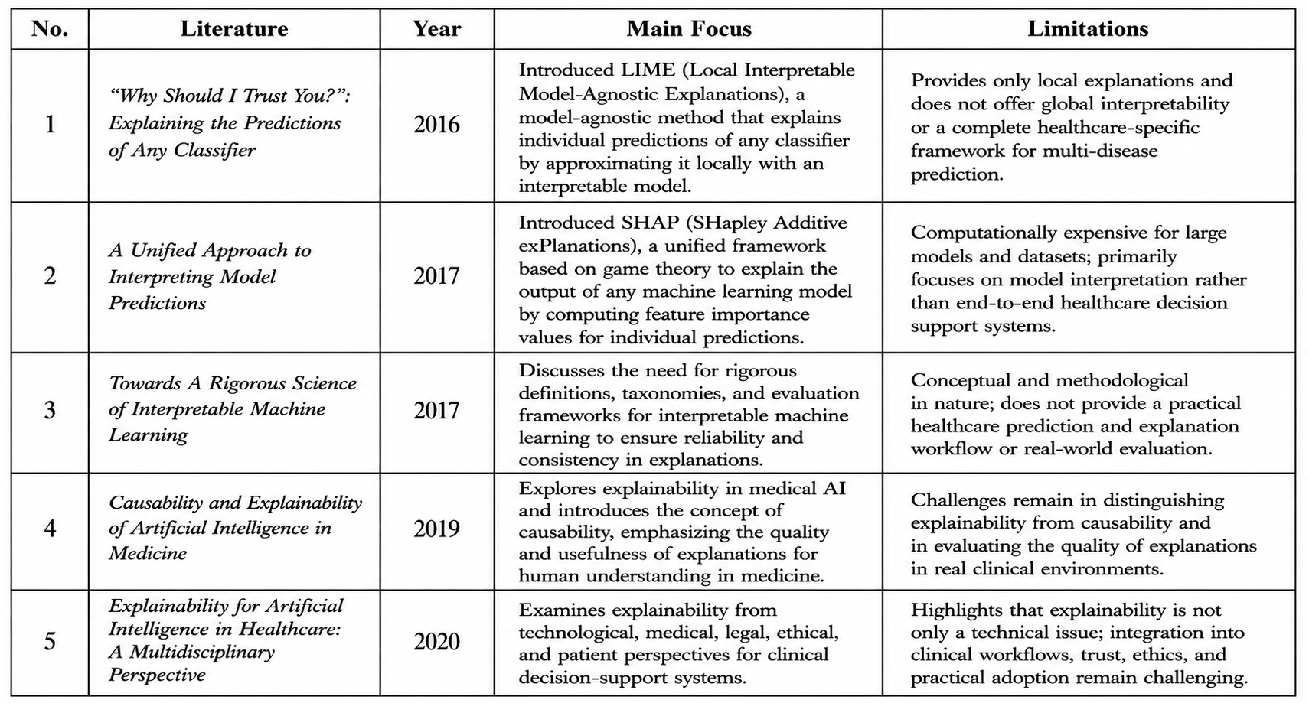
LITERATURE SURVEY

Slide 6
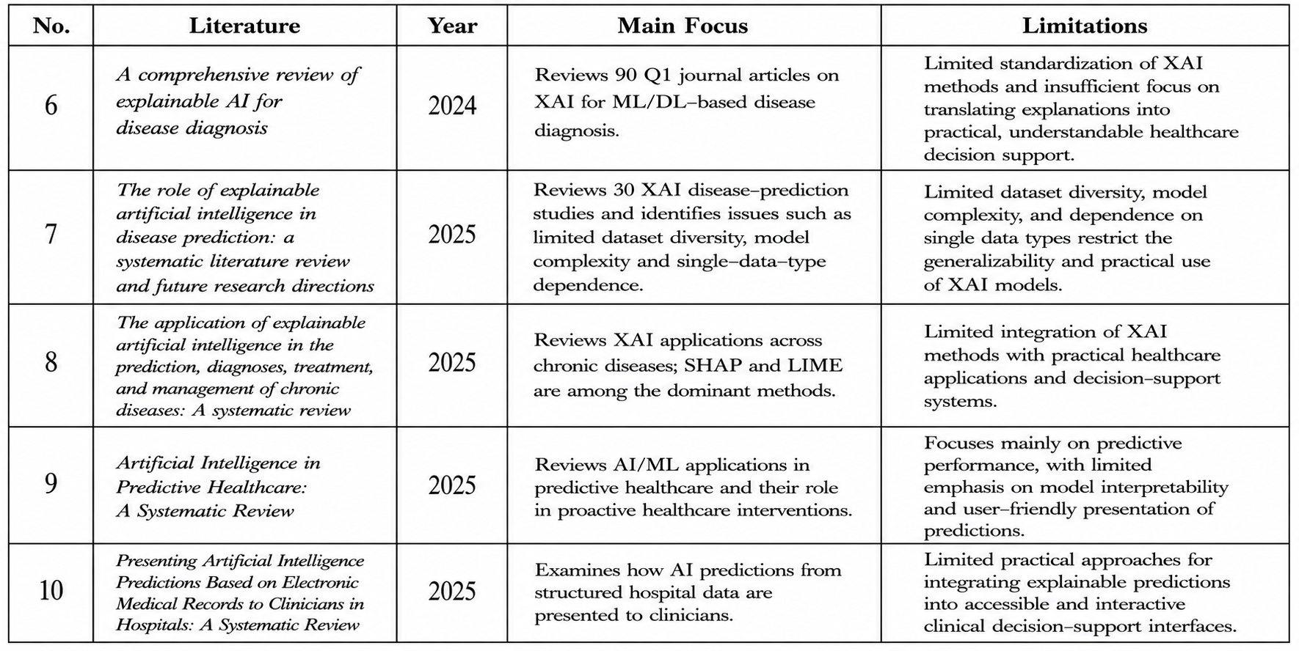
LITERATURE SURVEY (cont.)

Slide 7
RESEARCH GAP
1. Limited Dataset Diversity
Many existing studies rely on limited or single-disease datasets and single data types, reducing the generalizability and practical applicability of healthcare prediction models.
2. Disease-Specific Approaches
Existing research often focuses on individual diseases or specific datasets, with limited development of a reusable framework that can support multiple disease-risk prediction tasks.
3. Prediction vs. Interpretability
Several studies emphasize predictive performance, while model interpretability, transparency, and user understanding receive comparatively less attention.
4. Lack of an Integrated XAI Workflow
Although SHAP and LIME are widely used, they are often applied independently. There is a need for an integrated workflow combining prediction, global explanations, local explanations, and visualization.
5. Limited Practical Presentation and Decision Support
Existing studies provide limited accessible interfaces for users to understand risk probabilities, contributing factors, and model explanations, creating a gap between model development and practical healthcare decision support.

Slide 8
INNOVATION & CREATIVITY
Innovation & Creativity
End-to-End Healthcare Analytics – Integrates data preprocessing, analysis, prediction, and visualization.
Multi-Model Prediction – Compares multiple ML models with XGBoost for disease-risk prediction.
Explainable AI – Uses SHAP to identify the factors influencing each prediction.
Interactive Dashboard – Uses Streamlit to provide an easy-to-use healthcare prediction interface.
Visual Risk Insights – Presents risk probability, important features, and analytical charts clearly.

Slide 9
NOVALITY
Multi-Disease Prediction Framework – Supports disease-risk prediction across multiple healthcare datasets using different ML models.
Integrated Explainable AI (XAI) – Uses SHAP to provide both global and patient-level explanations for model predictions.
Interactive Healthcare Dashboard – Provides risk probabilities, important risk factors, model performance, and explanations through a Streamlit dashboard.
Streamlit Decision-Support Dashboard – Provides an interactive interface combining prediction, explanation, and visualization for practical healthcare decision support.
Comparative ML Model Evaluation – Compares multiple models, including Logistic Regression, Decision Tree, Random Forest, and XGBoost, using standard evaluation metrics.
End-to-End Decision-Support Workflow – Integrates data preprocessing → prediction → explanation → visualization → clinical decision support in a single framework.

Slide 10
FEASIBILITY ANALYSIS
Technical Feasibility
The project can be implemented using publicly available healthcare datasets and Python-based open-source libraries such as Pandas, Scikit-learn, XGBoost, SHAP and Streamlit.
Data Feasibility
Public benchmark datasets are available for heart disease, diabetes and stroke prediction, making initial experimentation possible without requiring private hospital records.
Implementation Feasibility
The system can initially be developed using Jupyter Notebook/VS Code and subsequently integrated into a Streamlit dashboard.
Time Feasibility
Phase 1 → Literature Survey & Dataset Collection
↓
Phase 2 → Data Cleaning & EDA
↓
Phase 3 → Feature Engineering
↓
Phase 4 → ML Model Development
↓
Phase 5 → Model Evaluation
↓
Phase 6 → SHAP Explainability
↓
Phase 7 → Streamlit Dashboard
↓
Phase 8 → Testing, Documentation & Final Report

Slide 11
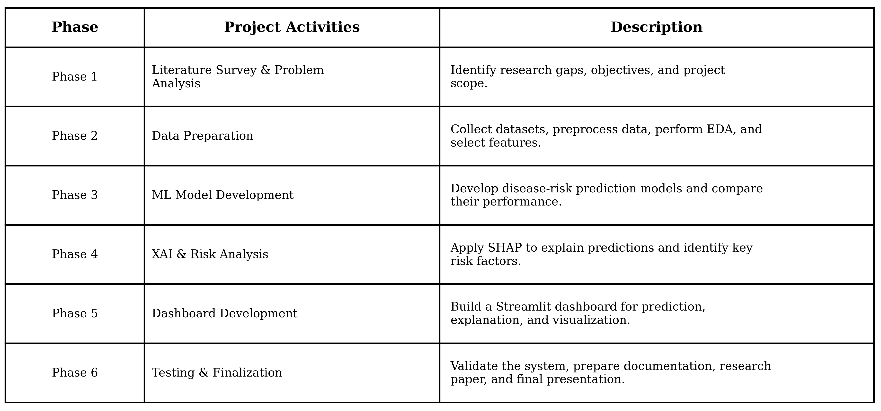
PROJECT PLAN

Slide 12
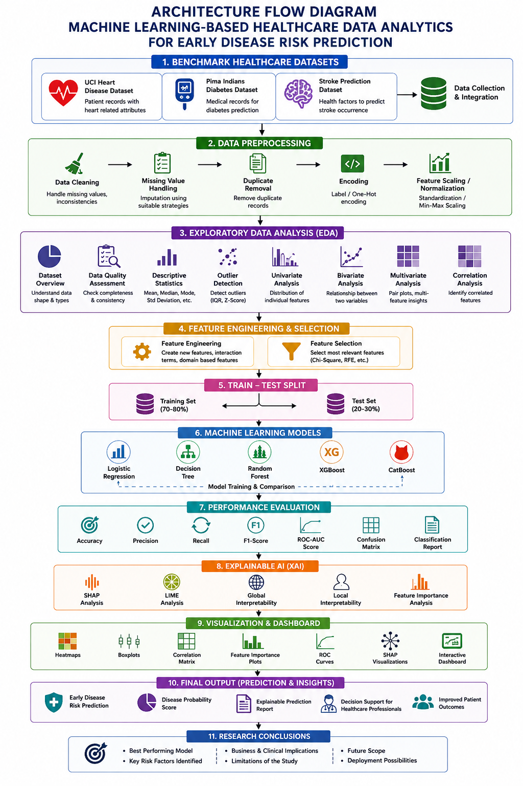
PROPOSED ARCHITECTURE/METHODOLOGY
Workflow
Data Collection
Data Preprocessing
EDA
Feature Selection
Train–Test Split
ML Model Training
Model Evaluation
XAI – SHAP/LIME
Dashboard & Visualization
Risk Prediction & Insights
Research Conclusion

Slide 13
Thankyou

